Slide 1
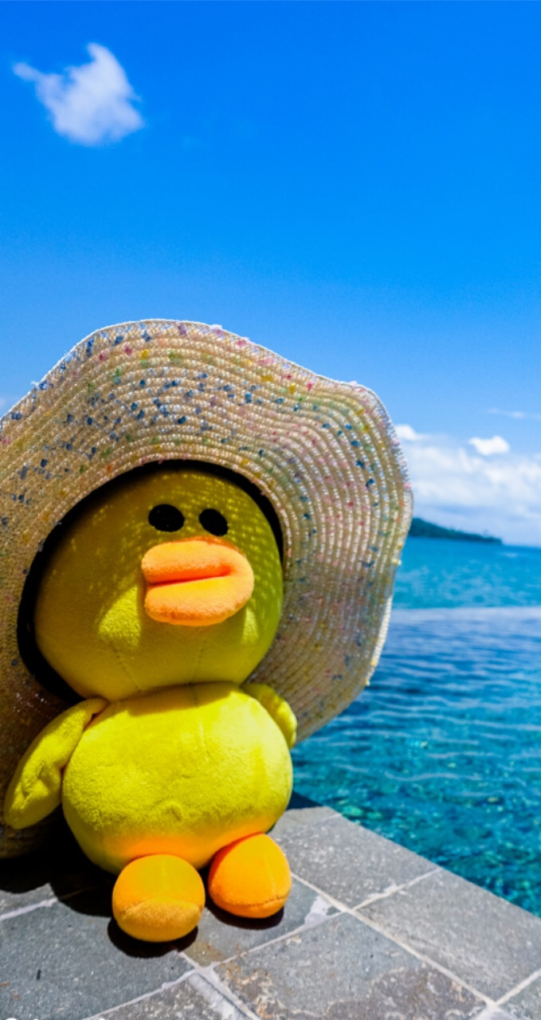
LUCKY O/X

Slide 2

X = Sit down
O = Stay
standing
The last student standing is the winner!!

Slide 3
What will you do this summer?
O
I will go to the beach.
O
X
O
I will read many books.
I will go to a science camp.
O
O
I will visit my cousin.
That sounds good.
X
O
I will make a robot.
What will you do for the Earth?
O
X
I will pick up trash.
I will save energy.

Slide 4
X
What will you do this summer?
I will go to the library.
O
O
X
I will go to the beach with my cousin.
I will read many books.
O
O
I will go to a science camp.
What are you doing?
X
O
I will visit my cousin.
The Earth looks sick.
X
O
I will turn off the lights.
I will use less plastic.

Slide 5
O
I will go to a science camp.
What will you do this summer vacation?
O
O
X
I will make a robot.
I will go to the beach.
O
O
I will read many books.
How about you?
X
X
I will visit my cousin.
What will you do for the Earth?
X
O
I will save water.
I will ride a bike.

Slide 6
What will you do this summer?
O
I will read many books.
O
O
O
I will go to the library.
I will go to a science camp.
X
X
I will visit my cousin.
What will you do there?
X
O
I will go to the beach.
What will you do for the Earth?
O
X
I will pick up trash.
I will turn off the lights.

Slide 7
What will you do this summer?
O
I will go to the beach.
O
X
O
I will make a robot.
I will read many books.
O
O
I will go to a science camp.
Summer vacation is coming.
X
X
I will visit my cousin.
Let's talk about the Earth.
O
X
I will save energy.
I will use less plastic.

Slide 8
X
What will you do this summer?
I will visit my cousin.
O
O
X
I will go to the library.
I will go to the beach with my cousin.
O
O
I will read many books.
That sounds great.
X
O
I will go to a science camp.
What will you do for the Earth?
X
O
I will ride a bike.
I will save water.

Slide 9
What will you do this summer?
O
I will go to a science camp.
O
O
X
I will make a robot.
I will visit my cousin.
O
O
I will go to the beach.
How about you?
X
X
I will read many books.
What will you do for the Earth?
X
O
I will pick up trash.
I will save energy.

